Slide 1
The Battle of Neighborhoods
Lisbon, Portugal

Slide 2
Business Problem
XPTO It is a real estate investment company, and in 2021 it intends to invest in the construction of several housing projects.
With this project we intend to help the XPTO company to choose which neighborhood has the most potential based on the distribution of various facilities available around the neighborhood. This project will use K-mean clustering unsupervised machine learning algorithm to cluster the venues based on the place category such as restaurants, parks, gyms, theaters clubs etc... In order to give a better understanding of the similarities and dissimilarities between the chosen neighborhoods to retrieve more insights and to conclude with ease which neighborhood wins over other.

Slide 3
Python Libraries and Dependencies:
Pandas - Data Analysis
NumPy – Handle data in a vectorized manner
JSON – Handle JSON files
Geopy – To retrieve Location Data
Requests – Library to handle http requests
Matplotlib – Python Plotting Module
Sklearn – Python machine learning Library
Folium – Map rendering Library

Slide 4
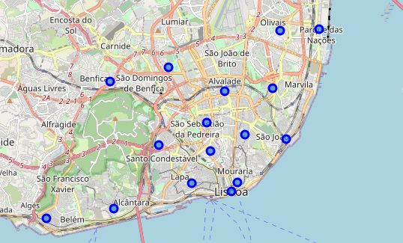
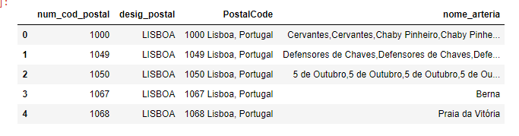
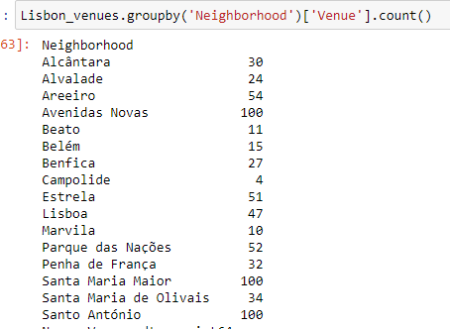
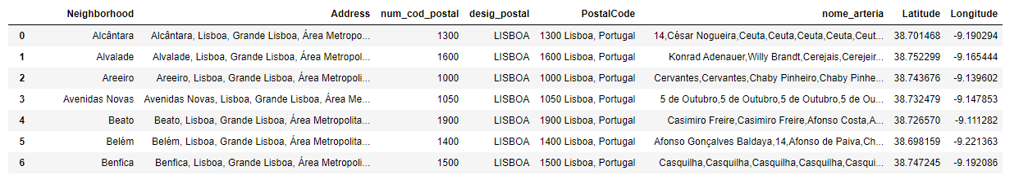
Data acquisition and Wrangling
Colecting Postal Codes
'http://centraldedados.pt/codigos_postais.csv'
Adding Geographical coordinates to neighborhoods using Geopy
https://pypi.org/project/geopy/
Folium Visualization of Lisbon Neighbourhoods
Venues Information Using Foursquare API

Slide 5
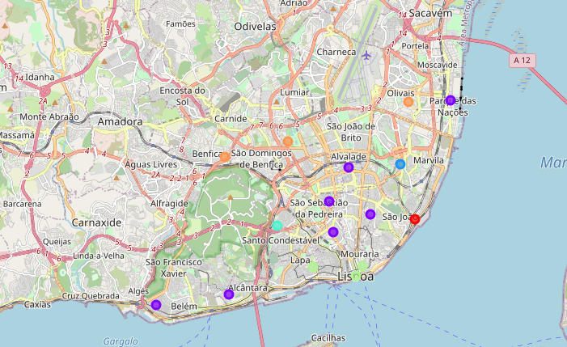
K-means Cluster Neighbourhood
Clusters map with k=6

Slide 6
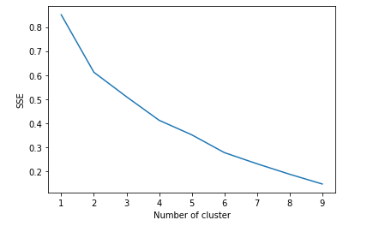
K-means: Choose the k
Elbow method is to run k-means clustering on a given dataset for a range of values of k and for each value of k and calculate sum of squared errors (SSE).

Slide 7

Silhouette Score
The Silhouette Coefficient is calculated using the mean intra-cluster distance (a) and the mean nearest-cluster distance (b) for each sample.
The formula for the Silhouette Coefficient of a sample is
(b - a) / max(a, b).
The best value is 1 and the worst value is -1. Values near 0 indicate overlapping clusters. Negative values generally indicate that a sample has been assigned to the wrong cluster.

Slide 8
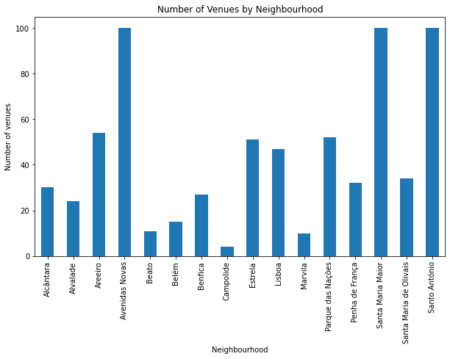
Neighbourhoods with more Venues

Slide 9
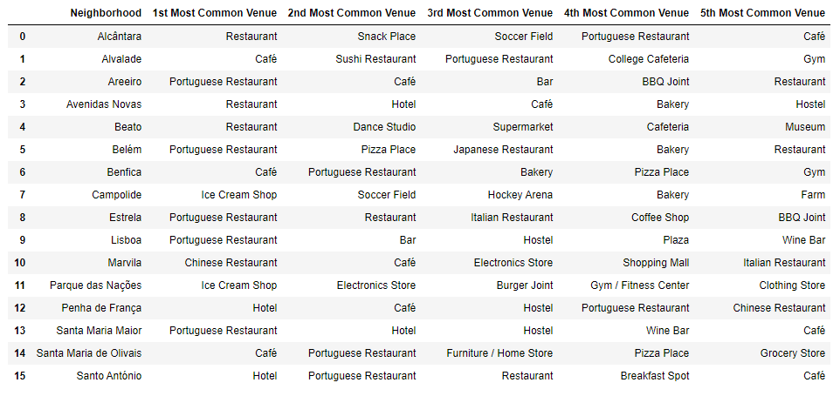
Top 5 Venues

Slide 10
Conclusion and next steps
This project concludes that the three best neighborhoods to due to the proximity of a large number and variety of venues are: Avenidas Novas, Santa Maria Maior and Santo Antonio
The Models accuracy can be improved by adding new datasets. Some examples of datasets that can bring a lot of valuable information:
Public Transports
Health Care Facilities
Schools
Noise measurements
Propriety price (€/m2)

